Slide 1
Plasma Diagnostic Techniques Lecture 11: Thomson scattering
Deborah O’Connell
York Plasma Institute

Slide 2
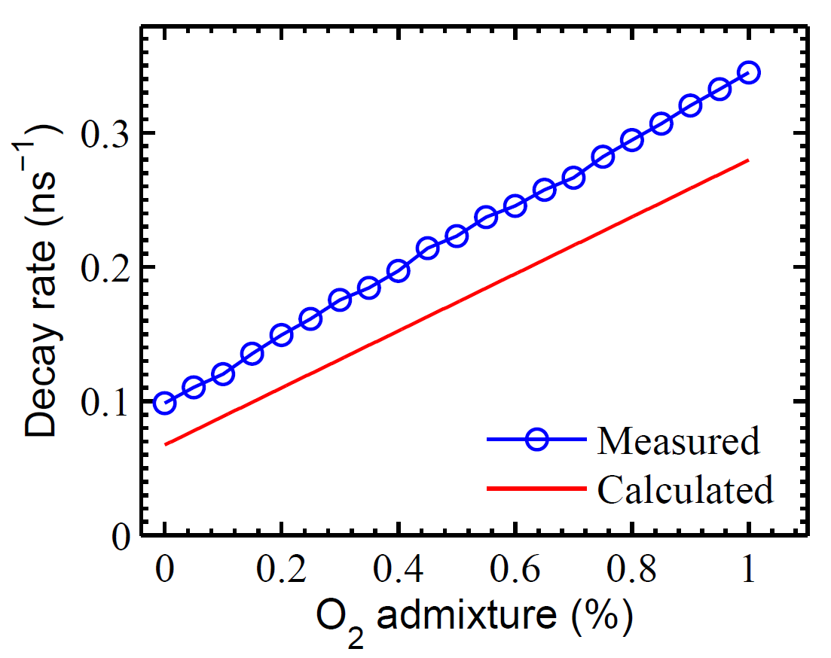
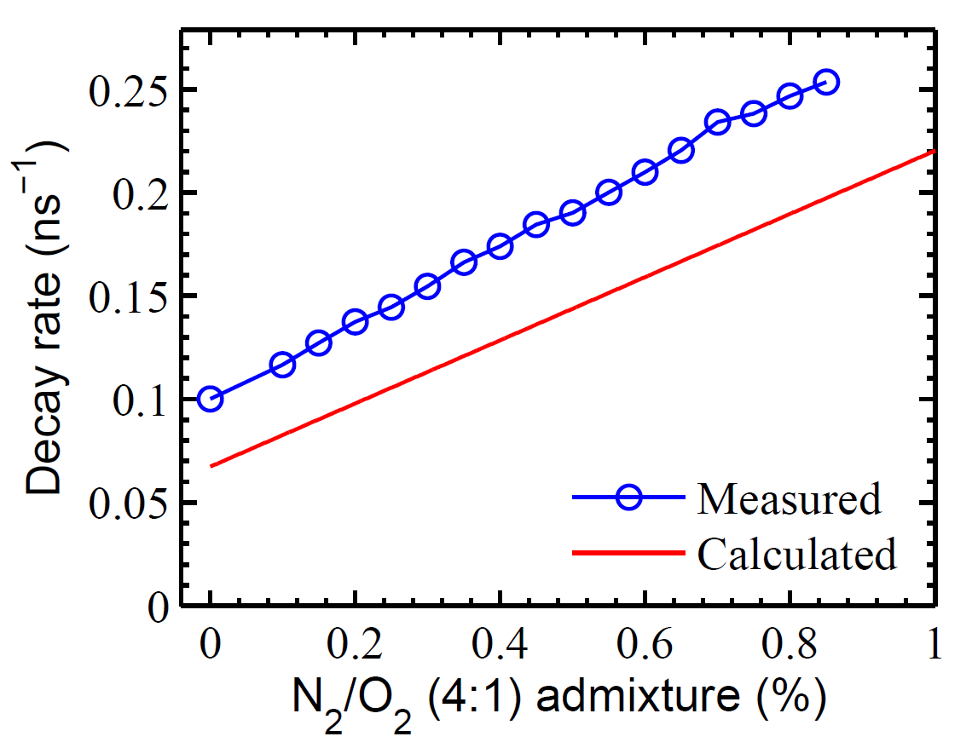
Measured vs calculated decay rate
Uncertainty in the calculated decay rate
➔ Error introduced in the density calculation
➔ For reliable density measurement, decay rate should be measured

Slide 3
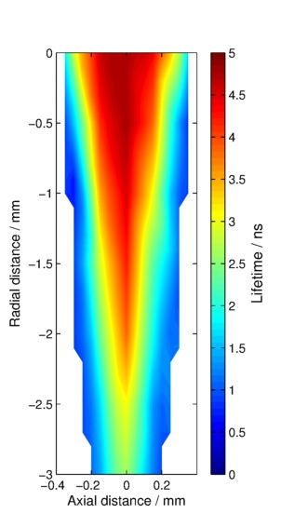
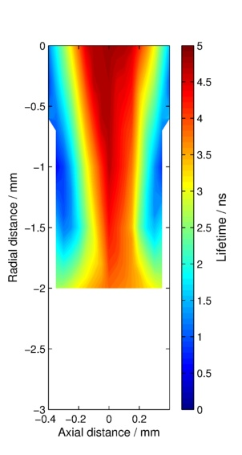
Influence of surface on lifetime
No surface
Surface at 2.5 mm

Slide 4
Thomson Scattering

Slide 5
Laser Light Scattering
Plasma
YAG:Nd Laser @ 532 nm
Free electrons → Thomson scattering
Bound electrons → Rayleigh scattering
Scattering by molecules → Raman Scattering

Slide 6
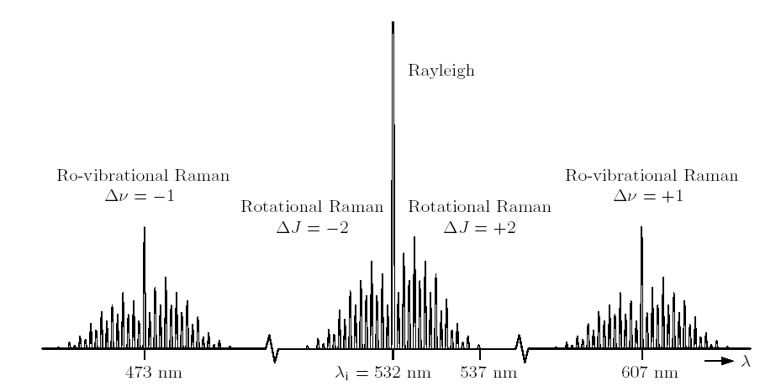
Rayleigh and Raman Scattering
Rayleigh and Raman scattering can be used to measure neutral particle densities.
The spectral distribution of Raman scattering depends on ro-vibrational distributions and hence provides a possibility to measure these.

Slide 7
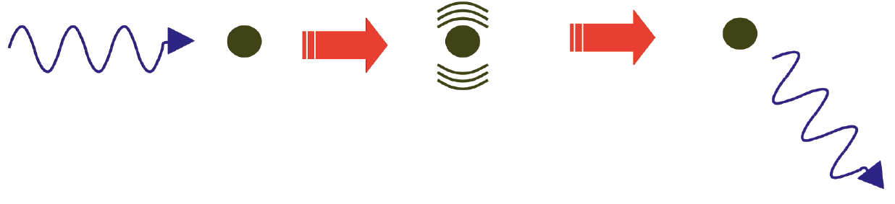
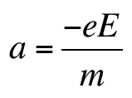
Thomson scattering
The electric field of an incoming photon accelerates free electrons.
The accelerated electrons emit radiation in form of a scattered photon.
The direction of the scattered photon can be different to the incoming photon.

Slide 8
Laser Thomson scattering
York Plasma Institute

Slide 9
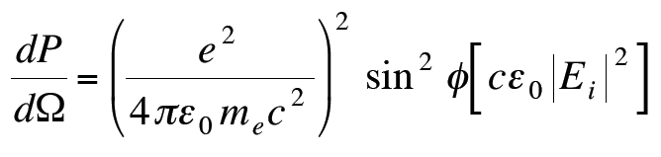
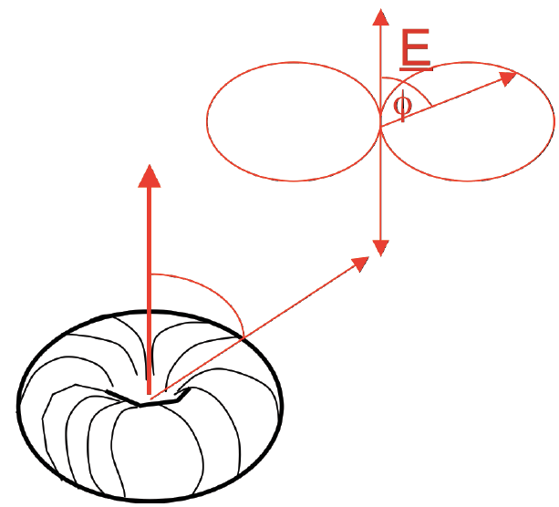
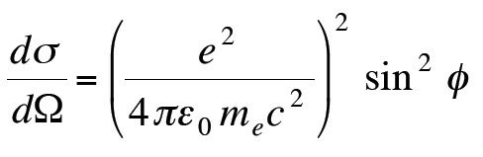
Thomson scattering
The power of the scattered light is given by:
This defines the Thomson scattering cross section to be:
This is a very small cross section which makes Thomson scattering experiments extremely challenging!

Slide 10
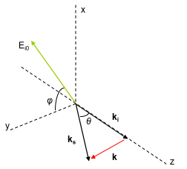



Thomson scattering
If an electron is moving with velocity v in the direction of the incident light wave (wavevector k₀) then, in our classical view, the electron oscillates at:
The scattered light is Doppler shifted and appears to the observer at:
Scattering geometry
1. Intensity of scattered light => electron density
Leading to:
2. Spectral distribution of scattered light => electron temperature (EEVF) (Doppler-effect!)
Notes:
2 Doppler effects occurring:
- Incoming light and moving electron
Accelerated electron and the observer
Wavevector = 2pi/lambda
(only sees component in direction of the laser)
wd – freq electron sees’
S - in direction of the observer
Ki (incoming wave), Ks (scattered wave),

Slide 11
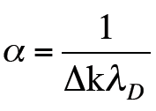
Scattering parameter
Scattering parameter:
The observation angle allows us to ‘tune’ between incoherent and coherent scattering regimes. Often the incoherent regime is preferred because of its ‘simplicity’, i.e. 90° observation, which also reduces unwanted stray light.
2π/Δk
2π/Δk
→ Incoherent scattering: Electron contributions dominate the scattered spectrum (typical for low plasma densities)
→ Coherent scattering: Ion contributions modify the scattered spectrum (typical for high plasma densities)
Notes:
If scattering is small compared to Debye length – collective behaviours don‘t play a role – only see electrons (only probing individual electrons)
Scattering parameter comparable to Debye length – see collective phenomena – ions and electrons interact on that lengthscale
High densities – small Debye length

Slide 12
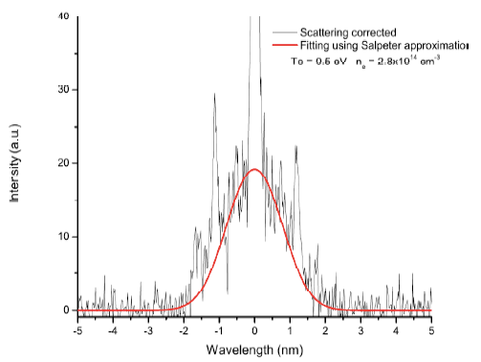
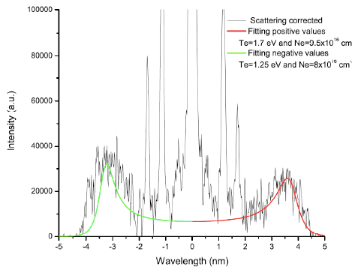
Scattering regimes
Incoherent scattering:
Coherent scattering:

Slide 13
Thomson scattering on MAST

Slide 14
Thomson scattering on MAST

Slide 15
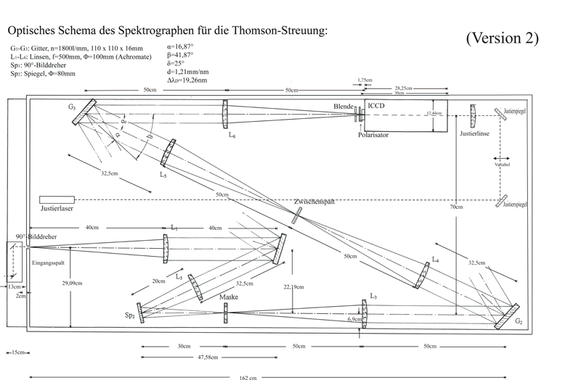
Practical challenges
Thomson scattering cross section is very small requiring high power lasers.
Stray light can be problematic, using a triple grating spectrometer can very efficiently reduce stray light.

Slide 16
Typical results
What is the x-axis?
What is the y-axis?
How does the density depend on pressure?
How does the temperature depend on pressure?

Slide 17
Typical results
What is the x-axis?
What is the y-axis?
How does the density depend on pressure?
How does the temperature depend on pressure?

